Slide 1
Microcontroller
8051

Slide 2
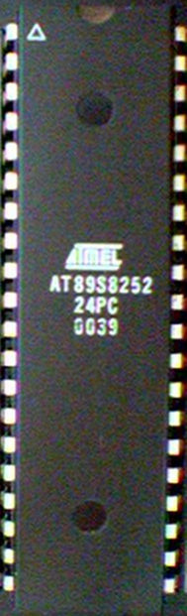

Slide 3
Why do we need to learn Microprocessors/controllers?
The microprocessor is the core of computer systems.
Nowadays many communication, digital entertainment, portable devices, are controlled by them.
A designer should know what types of components he needs, ways to reduce production costs and product reliable.

Slide 4
Different aspects of a microprocessor/controller
Hardware :Interface to the real world
Software :order how to deal with inputs

Slide 5
The necessary tools for a microprocessor/controller
CPU: Central Processing Unit
I/O: Input /Output
Bus: Address bus & Data bus
Memory: RAM & ROM
Timer
Interrupt
Serial Port
Parallel Port

Slide 6
Microprocessor vs. Microcontroller
Microprocessor
CPU is stand-alone, RAM, ROM, I/O, timer are separate
designer can decide on the amount of ROM, RAM and I/O ports.
expansive
versatility
general-purpose
Microcontroller
CPU, RAM, ROM, I/O and timer are all on a single chip
fix amount of on-chip ROM, RAM, I/O ports
for applications in which cost, power and space are critical
single-purpose
Notes:
versatility 多用途的: any number of applications for PC

Slide 7
Microprocessors:
General-purpose microprocessor
CPU for Computers
No RAM, ROM, I/O on CPU chip itself
Example：Intel’s x86, Motorola’s 680x0
Many chips on mother’s board
Data Bus
CPU
General-Purpose Micro-processor
I/O Port
Serial COM Port
RAM
ROM
Timer
Address Bus
General-Purpose Microprocessor System
Notes:
Intel’s x86: 8086,8088,80386,80486, Pentium
Motorola’s 680x0: 68000, 68010, 68020,68030,6040

Slide 8
Three criteria in Choosing a Microcontroller
meeting the computing needs of the task efficiently and cost effectively
  speed, the amount of ROM and RAM, the number of I/O ports and timers, size, packaging, power consumption
  easy to upgrade
  cost per unit
availability of software development tools
  assemblers, debuggers, C compilers, emulator, simulator, technical support
wide availability and reliable sources of the microcontrollers

Slide 9
8051 Basic Component
4K bytes internal ROM
128 bytes internal RAM
Four 8-bit I/O ports (P0 - P3).
Two 16-bit timers/counters
One serial interface
CPU
RAM
ROM
A single chip
Microcontroller
I/O Port
Serial COM Port
Timer

Slide 10
only 1 On chip oscillator (external crystal)
6 interrupt sources (2 external , 3 internal, Reset)
64K external code (program) memory(only read)PSEN
64K external data memory(can be read and write) by RD,WR
Code memory is selectable by EA (internal or external)
We may have External memory as data and code

Slide 11
Block Diagram
External interrupts
On-chip ROM for program code
Timer/Counter
Interrupt Control
On-chip RAM
Timer 1
Counter Inputs
Timer 0
CPU
Bus Control
Serial Port
4 I/O Ports
OSC
P0 P1 P2 P3
TxD RxD
Address/Data

Slide 12
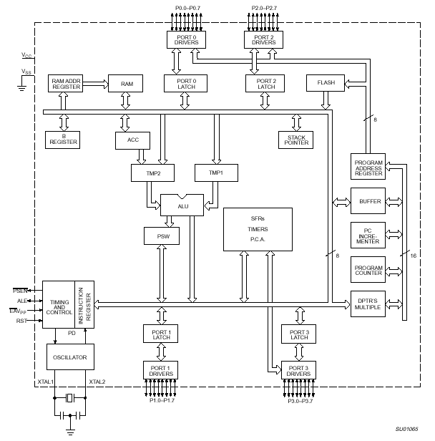
8051 Internal Block Diagram
Mahdi Hassanpour

Slide 13

Pin Description of the 8051
P1.0
1
40
Vcc
P1.1
2
39
P0.0(AD0)
P1.2
3
38
P0.1(AD1)
P1.3
4
8051
(8031)
37
P0.2(AD2)
P1.4
5
36
P0.3(AD3)
P1.5
6
35
P0.4(AD4)
P1.6
7
34
P0.5(AD5)
P1.7
8
33
P0.6(AD6)
RST
9
32
P0.7(AD7)
(RXD)P3.0
10
31
EA/VPP
(TXD)P3.1
11
30
ALE/PROG
(INT0)P3.2
12
29
PSEN
(INT1)P3.3
13
28
P2.7(A15)
(T0)P3.4
14
27
P2.6(A14)
(T1)P3.5
15
26
P2.5(A13)
(WR)P3.6
16
25
P2.4(A12)
(RD)P3.7
17
24
P2.3(A11)
XTAL2
18
23
P2.2(A10)
XTAL1
19
22
P2.1(A9)
GND
20
21
P2.0(A8)


Slide 14
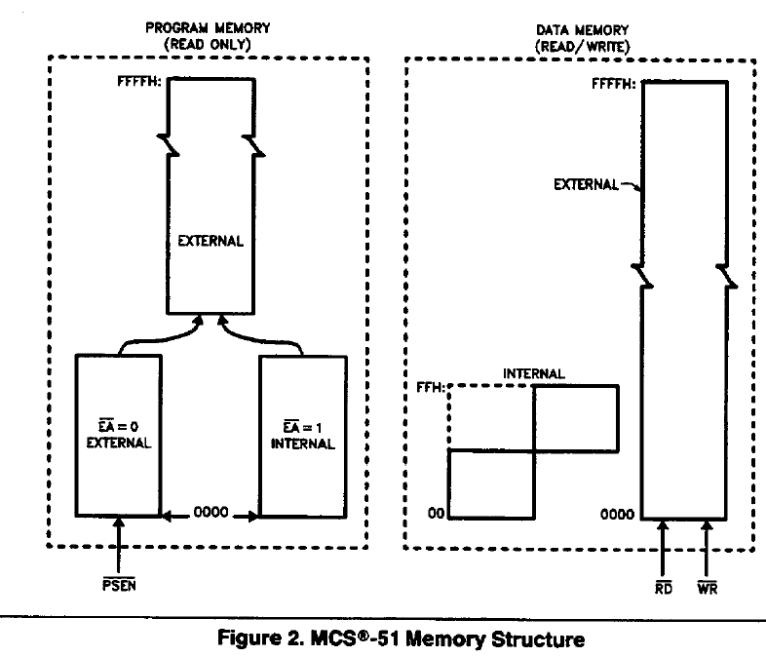

Slide 15
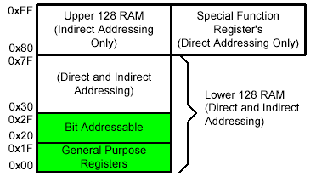
On-Chip Memory
Internal RAM

Slide 16
Registers
1F
18
Bank 3
Four Register Banks
Each bank has R0-R7
Selectable by psw.2,3
17
10
Bank 2
0F
08
Bank 1
07
06
05
04
03
02
01
00
R7
R6
R5
R4
R3
R2
R1
R0
Bank 0

Slide 17
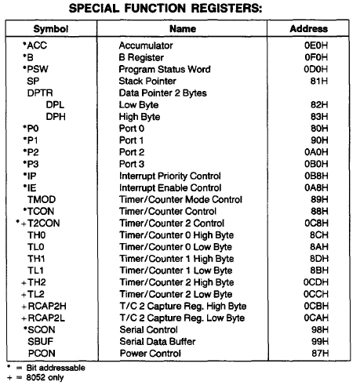

Slide 18
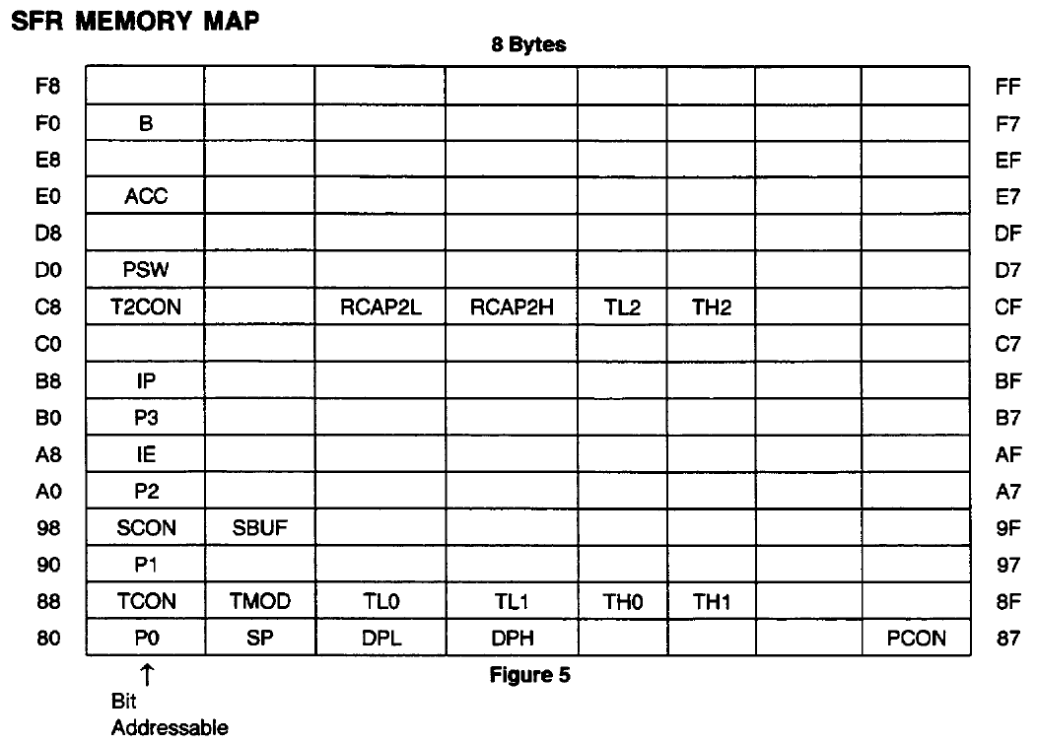

Slide 19
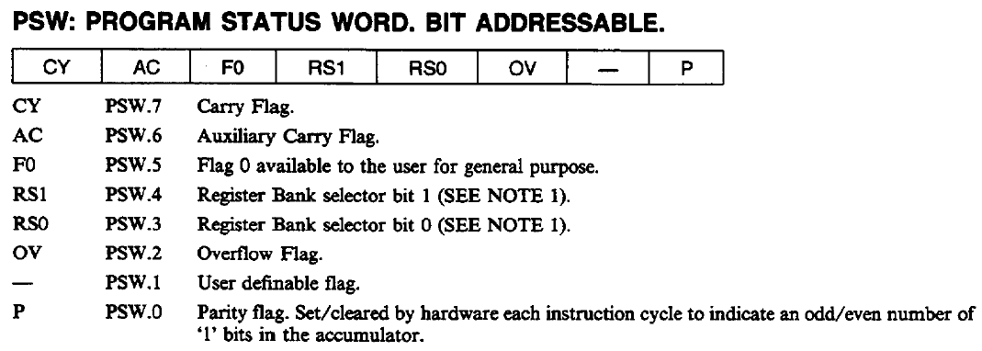
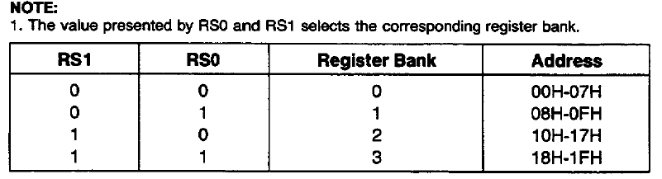

Slide 20
Registers
A
B
R0
DPTR
DPH
DPL
R1
R2
PC
PC
R3
R4
Some 8051 16-bit Register
R5
R6
R7
Some 8-bitt Registers of the 8051

Slide 21
MCS-51 instruction set
Arithmetic Instructions
Logical Instructions
Boolean Instructions
Data Transfers
Jump instructions

Slide 22
Arithmetic Instructions
Add
Subtract
Increment
Decrement
Multiply
Divide
Decimal adjust

Slide 23
Arithmetic Instructions
Mnemonic | Description
ADD A, byte | add A to byte, put result in A
ADDC A, byte | add with carry
SUBB A, byte | subtract with borrow
INC A | increment A
INC byte | increment byte in memory
INC DPTR | increment data pointer
DEC A | decrement accumulator
DEC byte | decrement byte
MUL AB | multiply accumulator by b register
DIV AB | divide accumulator by b register
DA A | decimal adjust the accumulator

Slide 24
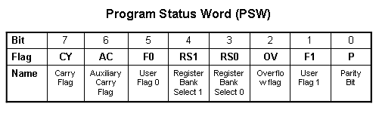
ADD Instructions
add a, byte ; a ← a + byte
addc a, byte ; a ← a + byte + C
These instructions affect 3 bits in PSW:
C = 1 if result of add is greater than FF
AC = 1 if there is a carry out of bit 3
OV = 1 if there is a carry out of bit 7, but not from bit 6, or visa versa.

Slide 25
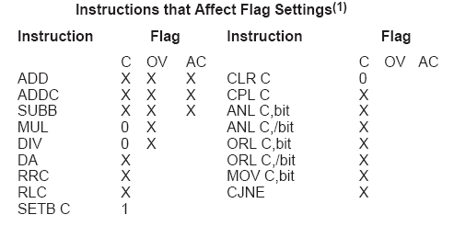
Instructions that Affect PSW bits

Slide 26
ADD Examples
mov a, #3Fh
add a, #D3h
What is the value of the C, AC, OV flags after the second instruction is executed?
0011 1111
1101 0011
0001 0010
C = 1
AC = 1
OV = 0

Slide 27
Addition Example
; Computes Z = X + Y
; Adds values at locations 78h and 79h and puts them in 7Ah
;------------------------------------------------------------------
X equ 78h
Y equ 79h
Z equ 7Ah
;-----------------------------------------------------------------
org 00h
ljmp Main
;-----------------------------------------------------------------
org 100h
Main:
mov a, X
add a, Y
mov Z, a
end

Slide 28
Logic Instructions
  Bitwise logic operations
      (AND, OR, XOR, NOT)
  Clear
  Rotate
  Swap
Logic instructions do NOT affect the flags in PSW

Slide 29
Bitwise Logic
Examples:
ANL ➔ AND
ORL ➔ OR
XRL ➔ XOR
CPL ➔ Complement
00001111
10101100
ANL
00001100
00001111
10101100
ORL
10101111
00001111
10101100
XRL
10100011
CPL
10101100
01010011

Slide 30
Other Logic Instructions
CLR - clear
RL – rotate left
RLC – rotate left through Carry
RR – rotate right
RRC – rotate right through Carry
SWAP – swap accumulator nibbles

Slide 31
Bolean Operations
Some logic operations can be used with single bit operands
  ANL C, bit
  ORL C, bit
  CLR C
  CLR bit
  CPL C
  CPL bit
  SETB C
  SETB bit
“bit” can be any of the bit-addressable RAM locations or SFRs.

Slide 32
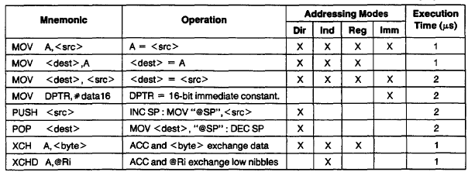
DATA TRANSFER INSTRUCTIONS

Slide 33
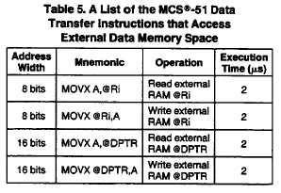

Slide 34
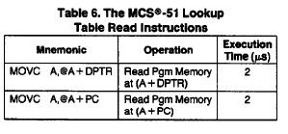

Slide 35
Program Flow Control
JUMP INSTRUCTIONS
Unconditional jumps (“go to”)
Conditional jumps
Call and return

Slide 36
Unconditional Jumps
SJMP <rel addr> ; Short jump, relative address is 8-bit 2’s complement number, so jump can be up to 127 locations forward, or 128 locations back.
LJMP <address 16> ; Long jump
AJMP <address 11> ; Absolute jump to anywhere within 2K block of program memory
JMP @A + DPTR ; Long indexed jump

Slide 37
Infinite Loops
Start: mov C, p3.7
mov p1.6, C
sjmp Start
Microcontroller application programs are almost always infinite loops!

Slide 38
Re-locatable Code
Memory specific NOT Re-locatable (machine code)
  org 8000h
  Start: mov C, p1.6
  mov p3.7, C
  ljmp Start
  end
Re-locatable (machine code)
  org 8000h
  Start: mov C, p1.6
  mov p3.7, C
  sjmp Start
  end

Slide 39
Conditional Jump
These instructions cause a jump to occur only if a condition is true. Otherwise, program execution continues with the next instruction.
  loop: mov a, P1
  jz loop ; if a=0, goto loop, ; else goto next instruction
  mov b, a
There is no zero flag (z)
Content of A checked for zero on time

Slide 40
Conditional jumps
Mnemonic | Description
JZ <rel addr> | Jump if a = 0
JNZ <rel addr> | Jump if a != 0
JC <rel addr> | Jump if C = 1
JNC <rel addr> | Jump if C != 1
JB <bit>, <rel addr> | Jump if bit = 1
JNB <bit>,<rel addr> | Jump if bit != 1
JBC <bir>, <rel addr> | Jump if bit =1, &clear bit
CJNE A, direct, <rel addr> | Compare A and memory, jump if not equal

Slide 41
More Conditional Jumps
Mnemonic | Description
CJNE A, #data <rel addr> | Compare A and data, jump if not equal
CJNE Rn, #data <rel addr> | Compare Rn and data, jump if not equal
CJNE @Rn, #data <rel addr> | Compare Rn and memory, jump if not equal
DJNZ Rn, <rel addr> | Decrement Rn and then jump if not zero
DJNZ direct, <rel addr> | Decrement memory and then jump if not zero

Slide 42
Iterative Loops
For A = 0 to 4 do
{…}
clr a
loop: ...
...
inc a
cjne a, #4, loop
For A = 4 to 0 do
{…}
mov R0,#4
loop: ..
djnz R0,loop

Slide 43
Iterative Loops(examples)
mov a,#50h
mov b,#00h
cjne a,#50h,next
mov b,#01h
next: nop
end
mov a,#25h
mov r0,#10h
mov r2,#5
Again: mov @ro,a
inc r0
djnz r2,again
end
mov a,#0aah
mov b,#10h
Back1:mov r6,#50
Back2:cpl a
djnz r6,back2
djnz b,back1
end
mov a,#0h
mov r4,#12h
Back: add a,#05
djnz r4,back
mov r5,a
end

Slide 44
Call and Return
Call is similar to a jump, but
  Call pushes PC on stack before branching
acall <address ll> ; stack ← PC
; PC ← address 11 bit
lcall <address 16> ; stack ← PC
; PC ← address 16 bit

Slide 45
Return
Return is also similar to a jump, but
  Return instruction pops PC from stack to get address to jump to
    ret ; PC ← stack

Slide 46
Subroutines
call to the subroutine
Main: ...
acall sublabel
...
...
sublabel: ...
...
ret
the subroutine

Slide 47
Why Subroutines?
Subroutines allow us to have "structured" assembly language programs.
This is useful for breaking a large design into manageable parts.
It saves code space when subroutines can be called many times in the same program.

Slide 48
example of delay
mov a,#0aah
Back1:mov p0,a
lcall delay1
cpl a
sjmp back1
Delay1:mov r0,#0ffh;1cycle
Here: djnz r0,here ;2cycle
ret ;2cycle
end
Delay=1+255*2+2=513 cycle
Delay2:
mov r6,#0ffh
back1: mov r7,#0ffh ;1cycle
Here: djnz r7,here ;2cycle
djnz r6,back1;2cycle ret ;2cycle
end
Delay=1+(1+255*2+2)*255+2
=130818 machine cycle

Slide 49
Long delay Example
GREEN_LED: equ P1.6
org ooh
ljmp Main
org 100h
Main: clr GREEN_LED
Again: acall Delay
cpl GREEN_LED
sjmp Again
Delay: mov R7, #02
Loop1: mov R6, #00h
Loop0: mov R5, #00h
djnz R5, $
djnz R6, Loop0
djnz R7, Loop1
ret
END
reset service
main program
subroutine

Slide 50
Example
; Move string from code memory to RAM
org 0
mov dptr,#string
mov r0,#10h
Loop1: clr a
movc a,@a+dptr
jz stop
mov @r0,a
inc dptr
inc r0
sjmp loop1
Stop: sjmp stop
; on-chip code memory used for string
org 18h
String: db ‘this is a string’,0
end

Slide 51
Example
; p0:input p1:output
mov a,#0ffh
mov p0,a
back: mov a,p0
mov p1,a
sjmp back
setb p1.2
mov a,#45h ;data
Again: jnb p1.2,again ;wait for data request
mov p0,a ;enable strobe
setb p2.3
clr p2.3

Slide 52
Example
; duty cycle 50%
back: cpl p1.2
acall delay
sjmp back
back: setb p1.2
acall delay
Clr p1.2
acall delay
sjmp back

Slide 53


Slide 54
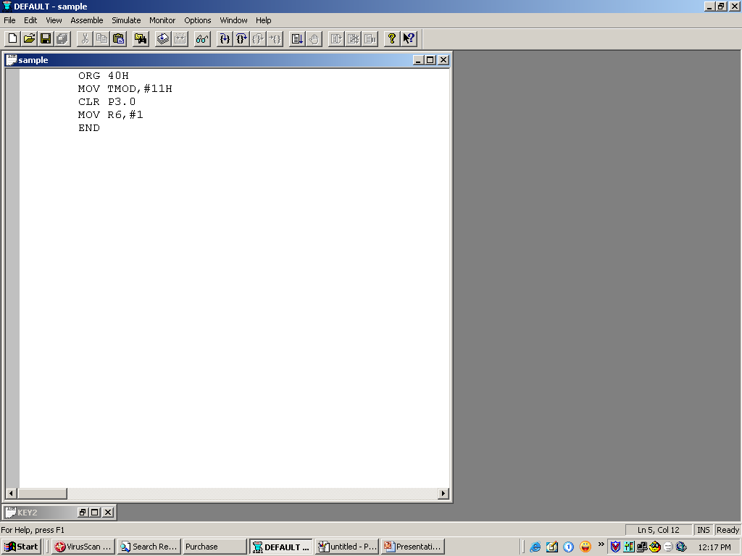

Slide 55


Slide 56
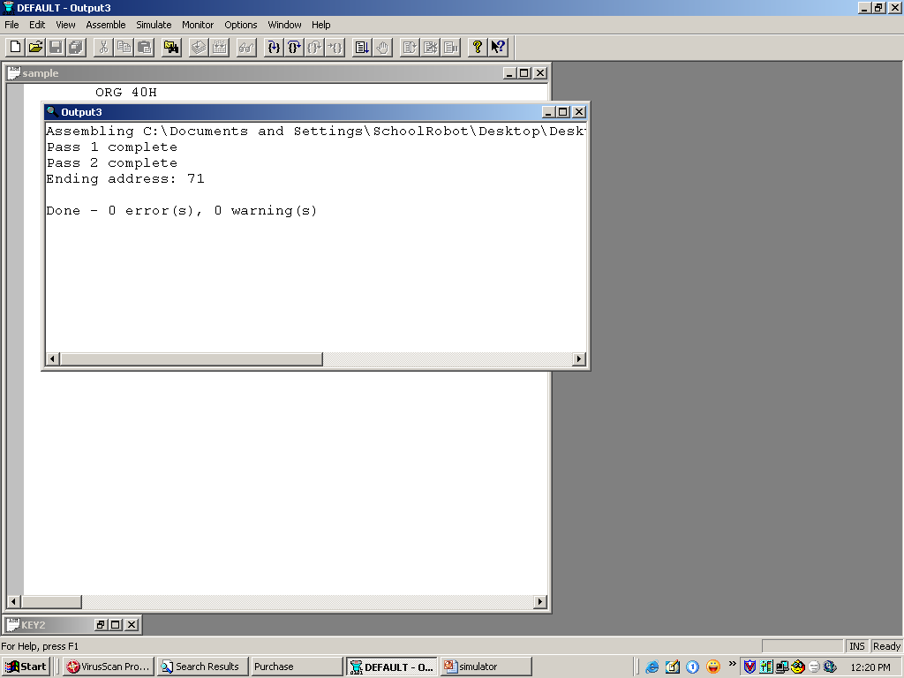

Slide 57
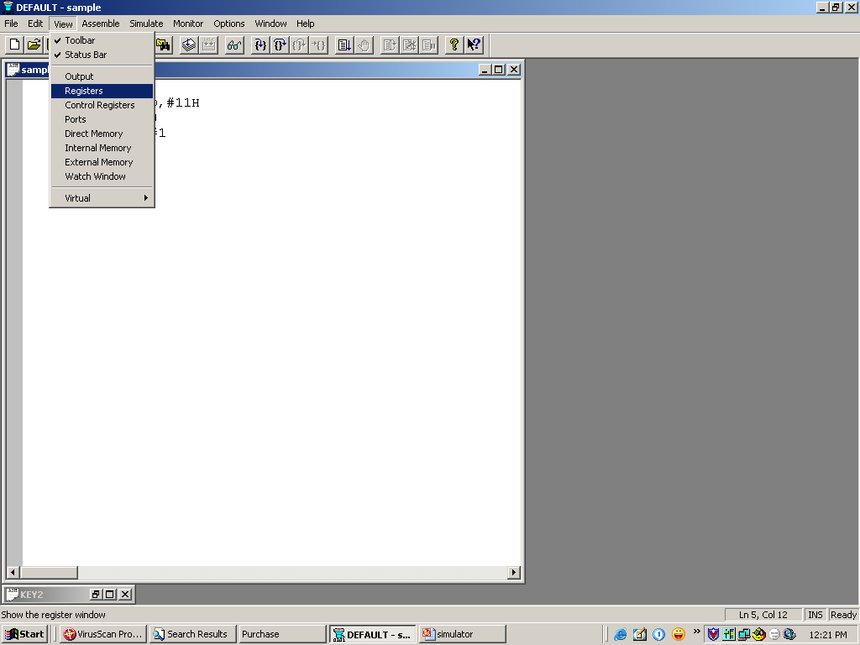

Slide 58
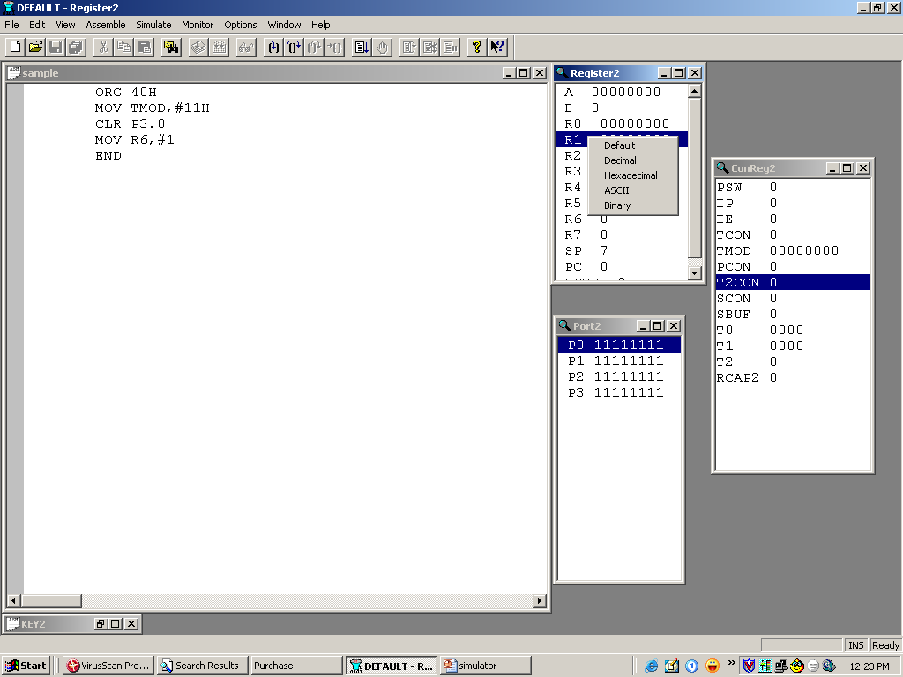

Slide 59
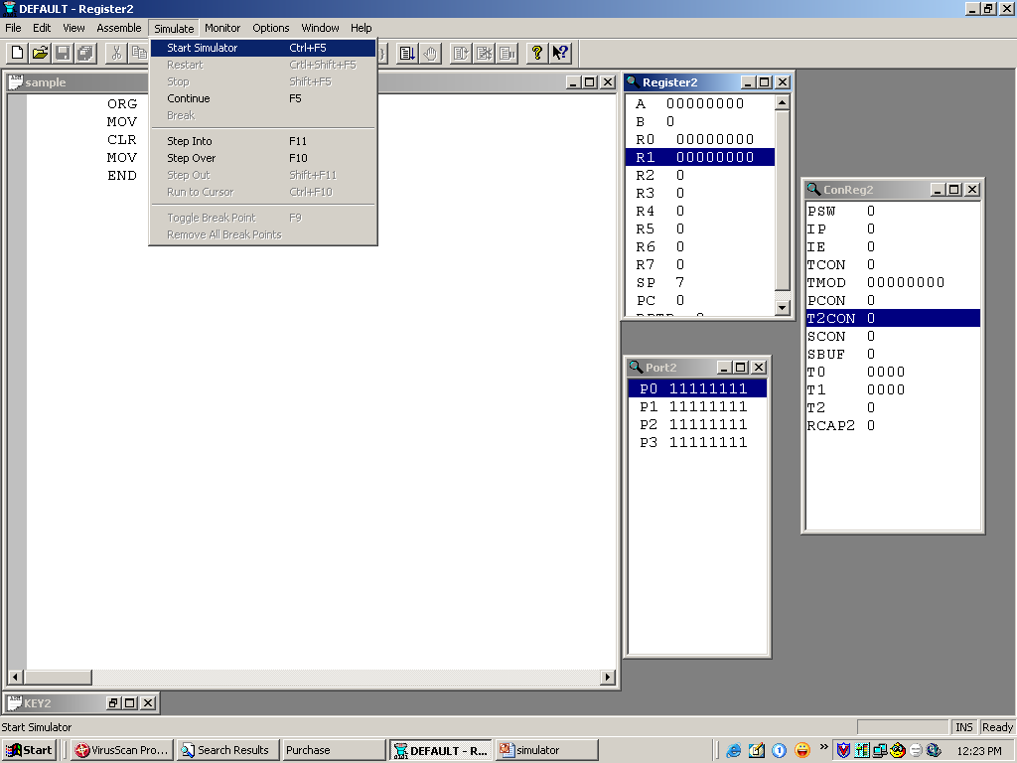

Slide 60
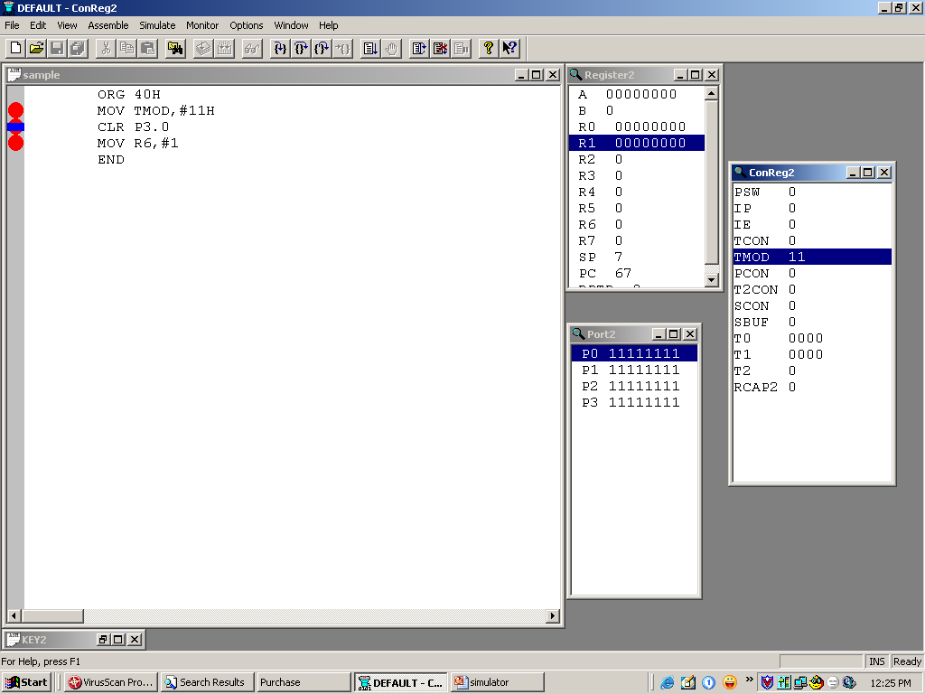

Slide 61
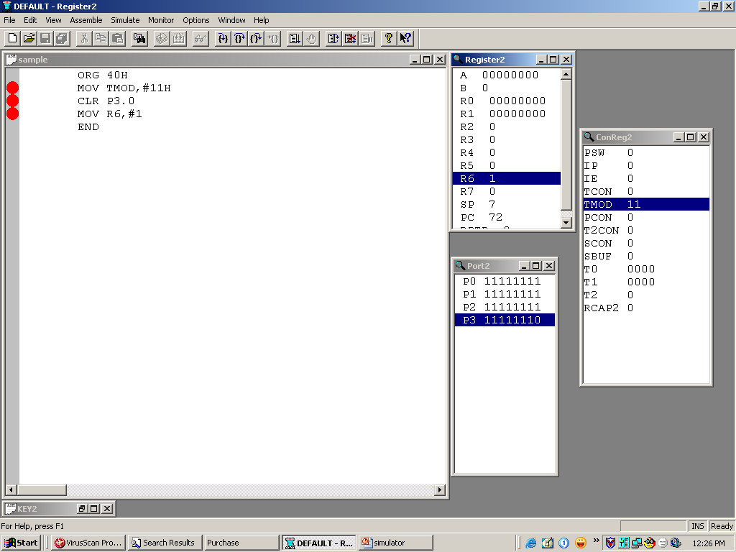

Slide 62
?????
THANK YOU

